Slide 1
PIP104 University Project-II
Review-1
PROJECT TITLE - Sentinel: Intelligent Multi Camera Face Detection, Recognition And Tracking System For Advanced Video Surveillance
Batch Number: G17
Roll Number | Student Name
Under the Supervision of,
20201CAI0128 RISHI RAGAV V
20201CAI0107 ISRAR AHMED
20201CAI0117 RAKSHITH MB
20201CAI0090 MD FAIZAN USMAN SAIT
Mr. SK JAMIL AHMED
Assistant Professor
School of Computer Science & Engineering
Presidency University

Slide 2
Abstract
Video and Security surveillance assistant using the current technological advancements like Artificial Intelligence, Machine Learning, Computer Vision and Face Tracking.
Using these technology to create an end to end solution for monitoring and video surveillance.

Slide 3
Literature Survey
It was found that computer vision is a data heavy and computationally expensive process that required powerful system and high quality as well extensive dataset. Hence models were trained in the server side so that the user can focus on other parts of their project. The application of edge computing where the use of training data locally on the device itself has become popular. To facilitate this process, there has been improvements made in the field of computer vision and machine learning algorithms. One such example is YOLO V8 whose highlighting features are transfer learning, improved loss function and improved speed for data crunching of large datasets. The architecture is given by 8 convolution layers and 4 maxpool layers.

Slide 4
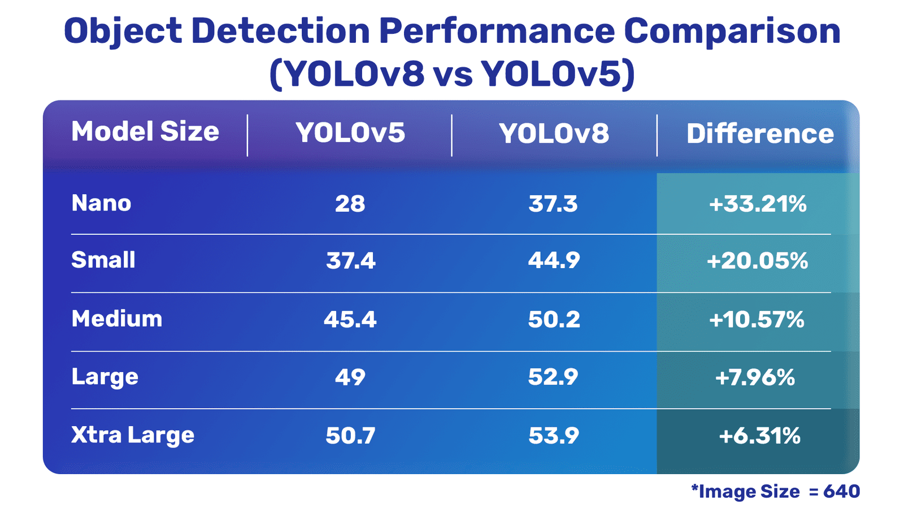

Slide 5
Objectives
Primary Objectives
1. Enhanced Face Detection: Develop a highly accurate face detection algorithm that can efficiently identify and locate faces in real-time, regardless of variations in lighting conditions, angles, and facial expressions.
2. Robust Face Recognition: Create a robust face recognition system that can match detected faces to a pre-defined database of individuals, allowing for the positive identification of persons of interest and generating alerts as necessary.
3. Multi-Camera Integration: Implement the capability to seamlessly integrate with multiple cameras across a surveillance network, enabling simultaneous monitoring and tracking of individuals across different camera views.
4. Real-Time Tracking: Develop an intelligent tracking system that can monitor and track recognized faces as they move within the camera network, providing real-time information on their whereabouts and activities.
5. Alert and Reporting System: Design a comprehensive alert and reporting system that can automatically generate alerts for suspicious activities, unauthorized access, or individuals on watchlists, and provide detailed reports for post-incident analysis and evidence gathering.
Optional Objectives
1. Behavioral Analysis: Incorporate behavioral analysis algorithms to detect and alert on unusual or suspicious activities, such as loitering, sudden crowd dispersal, or unusual gestures, enhancing the system's overall security capabilities.
2. User-Friendly Interface: Develop an intuitive and user-friendly interface for security personnel to interact with the system, allowing for easy configuration, monitoring, and response to incidents, and potentially enabling remote access and control for authorized personnel.

Slide 6
Proposed Method
Start State:
Create/Update dataset
Train the model on the dataset
Apply machine learning and deep learning techniques for face detection
Use the current data and refine the model until satisfactory result is achieved.
End State:
Apply Evaluation methods and check for accuracy and other pertinent factors
Continuously track the person and generate real time data
Apply machine learning and deep learning techniques for face recognition
Fig 1. Flowchart of the process

Slide 7
Hardware and Software Details
Hardware Components:
Web camera
Requirement to run the model : 8GB GPU minimum(Tested for yolov8m)
Minimum usage for training: 7.1 GB.
Software Components:
Roboflow – create and instantiating dataset
Visual Studio code – Code Editor Github – Collaborative coding
Google Colab – Model Training
Minimum images to be trained on 100 unique image per person -> later converted to other types by adding blur, rotate and other types of image manipulation. Final image count: minimum 400 without image manipulation and 1200 after image manipulation
Epochs to be trained on 100-500.
Each epoch duration - 5 to 7 seconds (tested on 28 uploaded image dataset).

Slide 8
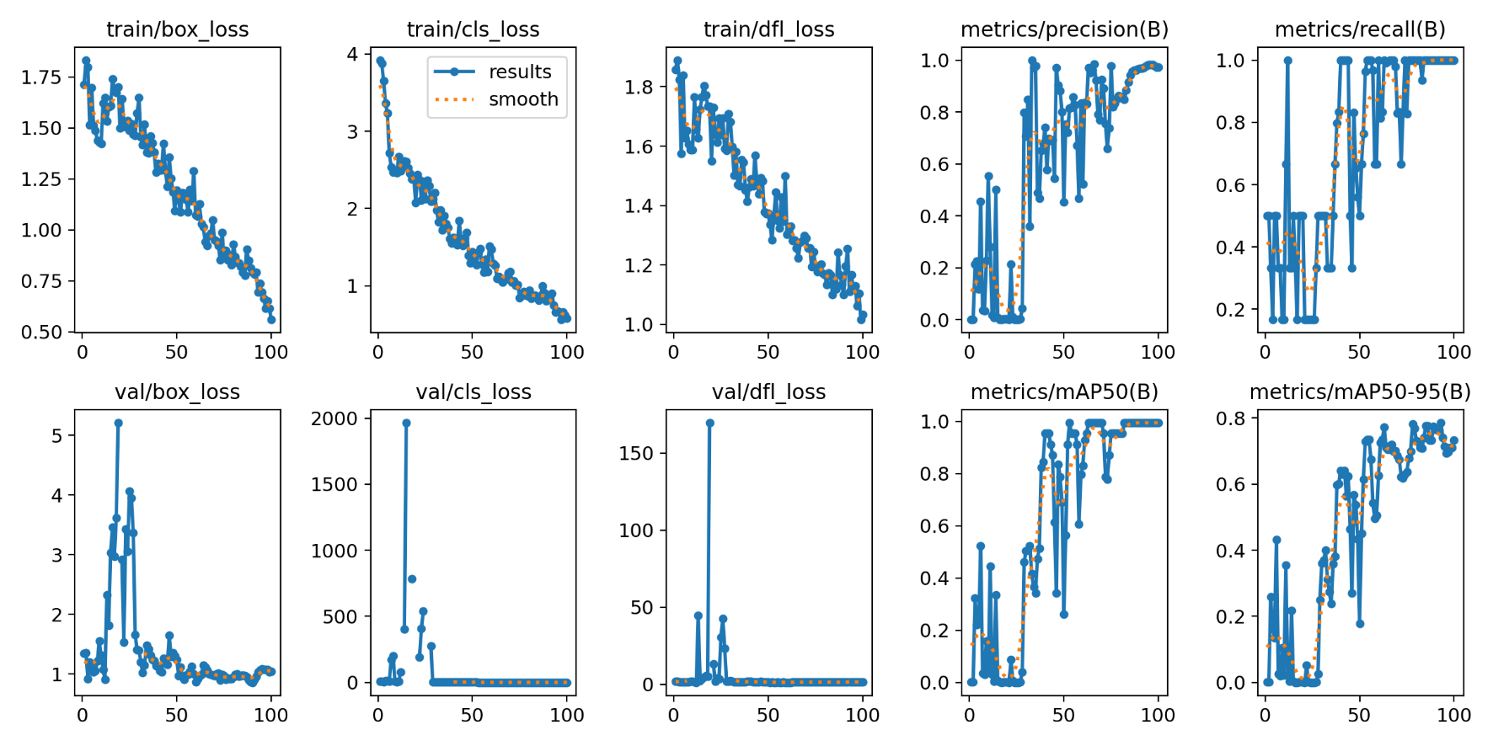
Preliminary Result

Slide 9
Gantt Chart
Oct 10 - Oct 12
Title Finalization
Oct 10 - Oct 14
Objectives
Oct 18 - Nov 1
Literature Survey
Oct 27 - Nov 8
Architecture
Oct 21 - Nov 8
Dataset preparation
Review 0
Review 1
Oct 20
Nov 8
Week 1
2
3
4
5
Today
2023

Slide 10
Thank You

